Slide 1

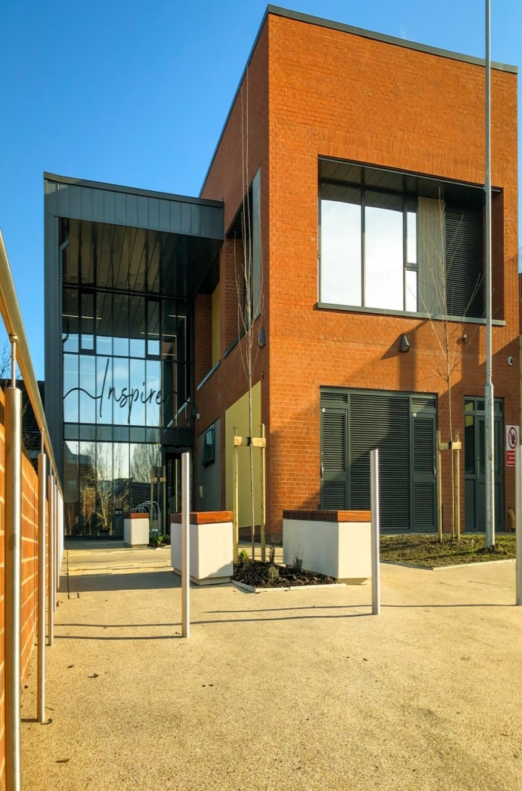

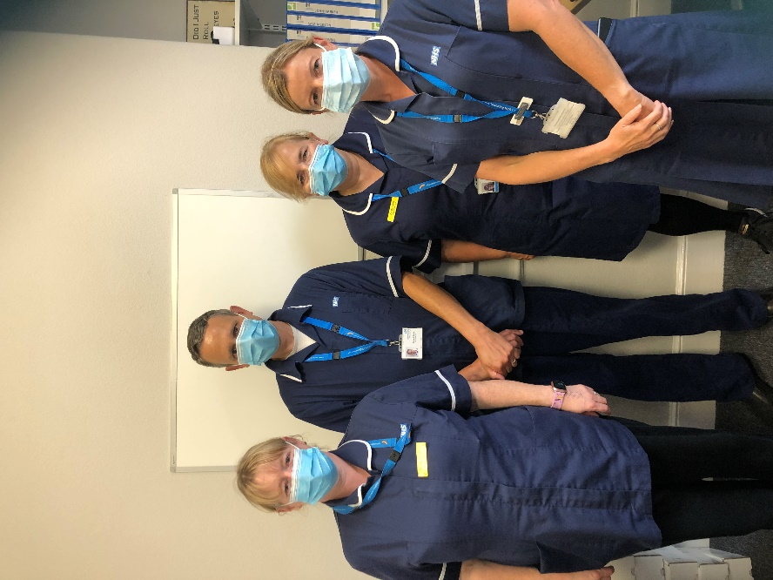






CONTACT US
Community Services for Scarborough, Ryedale, Whitby and Pocklington
Tel: 01653 609609
Email: hnf-tr-csspoc@nhs.net
Please contact your GP, or 111 (which is available 24 hours a day, 7 days a week),
if you have an urgent medical problem and you’re not sure what to do
Please call 999 in the event of a life threatening emergency
Community District Nursing Service
Scarborough, Ryedale, Whitby, and Pocklington Community
Humber Teaching NHS Foundation Trust
Complaints and Feedback team
Humber Teaching NHS Foundation Trust
Trust Headquarters
Willerby Hill
Beverly Road
Willerby
HU10 6ED
Respect—Our staff will treat you with dignity and respect at all times. We expect polite behaviour towards our staff
No Smoking -To protect the health of our staff we will request that you do not smoke during our visits.
01482 303930
HNF-complaints@nhs.net
HumberNHSFT
HumberNHSFT
humber.nhs.uk
Publication Date: Feb 2022
Review Date: Feb 2024
Notes:
GUIDE:
Before saving as a PDF file for printing purposes, make sure to DELETE the two blue separating ‘fold’ lines.

Slide 2
Who is this service for?
A health or Social Care Professional has agreed with you that you or the person you are caring for may be experiencing difficulties at home, which need a nurse to visit and help with. Examples of when you might need this service include:
Leg ulceration and wound care management
Bladder and bowel care
Palliative and end of life care
Diabetes care
Injectable medication
Support and treatment of chronic disease/ frailty
Diagnostic tests – for example blood and urine tests
Why you might need this service?
You might need this service if:
You are over the age of 18
You are living in your own home or a residential/care home setting and are unable to get to your GP Practice or Health Centre
As part of a package of care which helps you to stay at home.
Equipment Provision
It may be helpful to supply you with equipment to enable you to be at home. Examples include; commodes and pressure relieving mattresses.
Equipment is supplied through an outside company called Medequip and will be delivered to your home.
How this service might be able to help you (not an exhaustive list):
During a rapid decline linked with frailty
Palliative care/end of life crisis support
Provision of health education and
support, allowing patients to be
responsible for their own health
Support and treatment for
patients with chronic diseases
Advice and the supply of
equipment to promote
independence and/or comfort
Nursing care and advice after hospital admission
Prevention of hospital admissions/
readmissions
What does the service do?
As part of our Community Services, we have a team of Nurses and Support Workers, who can provide nursing help at home to help people living with frailty, multiple long term health conditions, and/or complex needs to stay at home for as long as possible.
This care is available to people in their home or usual place of residence, which includes residential care homes. Nursing Homes already have a nursing team on site, but sometimes the District Nursing Team will support if specialist skills are needed.
The team will assess your health needs with you and plan the care which is needed. The team will try to visit at a time which fits in with your routines and health needs, however timings of visits can not always be agreed in advance, as the service supports planned and unplanned patient need throughout the day.
When is the service delivered?
The service operates 7 days a week, from 08:00 to 22.00 (with dedicated overnight service provision currently in Whitby)
Who does this service work with?
GP Practices, Hospital Discharge Teams, NHS 111 and ambulance services, and social care teams, as well as working alongside mental health, housing sector, voluntary sector, and other therapy and specialist community teams.
A referral to the team will usually be made from your GP Practice or on discharge from hospital, following a discussion with you.
How long can the team support you?
This depends on your individual assessment and health needs, and will be discussed with you. We may also discuss with you referral to other community health and social care or voluntary sector providers, to support your ongoing care.
Which area is covered by this service?
The service is delivered to patients registered with a GP Practice across Whitby, Scarborough, Ryedale, and Pocklington Community. There is no charge for this service.
Who do you call if you have any questions?
Please feel welcome to contact the team via our Single Point of Contact. (SPoC)
if you have any queries or concerns, and a Health Care Professional will get back to you.
The telephone number is: 01653 609609.
Supporting young people
and their families in Hull and
the East Riding of Yorkshire.
Notes:
GUIDE:
Before saving as a PDF file for printing purposes, make sure to DELETE the two blue separating ‘fold’ lines.

