Slide 1

Understanding Recovery

Slide 2

Reflections and Discussions on the term ‘Recovery’
XaOk8K0j3lHDJuOHvSPt | Riseup Pad

Slide 3
What does Recovery mean to YOU?
Pen and paper / typed

Slide 4
Able to live a full, happy, productive life, within my realistic parameters, at home in the community - with support from services if and when necessary.
It’s the process of choosing what steps (big and small) you take to move forward - with me or others as support - towards your own understanding and definition of Recovery.
A movement away from patriarchal, traditional, institutional approaches to mental health. A redistribution of power.
Learning to self-manage mental health symptoms as far as I'm able… but getting person-led help when I need it.
Survival
I think it can be helpful to think about Recovery as a continuum that everyone is on somewhere.
To feel safe and largely content with my thoughts and feelings so that it does not have a negative impact on my day.
Working on my own self-health with support from professionals (who do not merely dole out pharmaceuticals but KNOW about therapy, prevention, self-care and other strategies) to help keep me well and flourishing.
Trying to put things back to where they should be.
Difficulties still exist but they’re no longer your entire existence – you learn to manage and live with things that have previously been detrimental.
Being whole again, OR being on the road to wholeness / wellness, OR having accepted one's limitations.
Using my voice
“A meaningful life beyond diagnosis without having to be symptom free.”

Slide 5
'Recovery’ in mental health
= a term used to describe the personal lived experiences and healing journeys of ‘people with severe and enduring mental health conditions with long term needs’
(Deegan, 1998, Anthony, 1993)

Slide 6
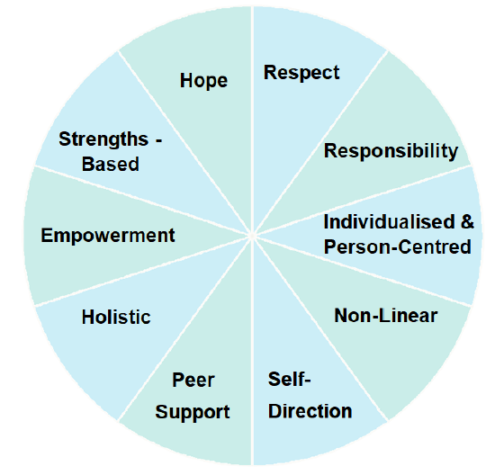
Recovery is personal
Recovery is a non-linear process of rebuilding after a crisis, taking responsibility for personal wellbeing and learning to live alongside any continued symptoms or impairments without the pressure to eventually be symptom-free.
By focusing on existing and potential strengths, skills and resources, an individual can pursue what they consider to be a satisfying and meaningful life.
Learning from one’s peers, someone can work towards their own self-defined goals at their own pace. A collaborative, holistic and person-centred approach to care empowers people to lead the way in decision-making.
This process of rediscovery is often known as a ‘Recovery Journey’.
SAMSHA’s ‘Components of Recovery’

Slide 7
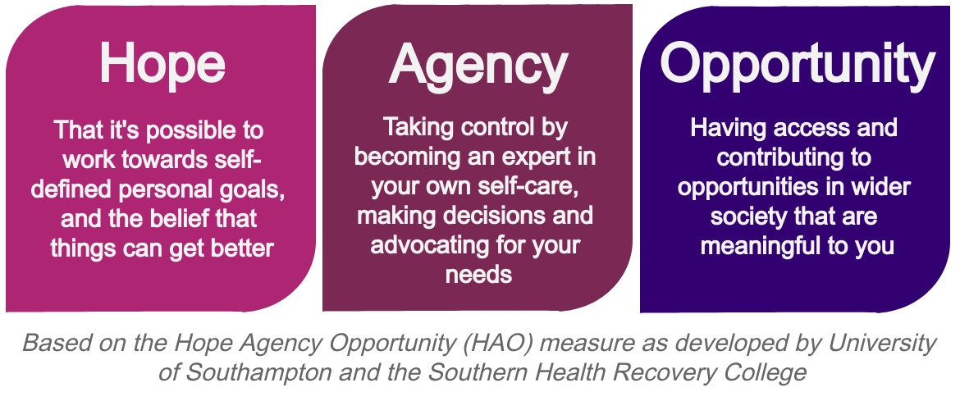
Principles of Recovery
Hope: Believing in self, others believing in us when we’re unable to, possibility of rebuilding life and achieving self-defined goals
Opportunity: Pursuing the things you value that make life worthwhile, prospects for meaningful activity, chance to move towards self-defined goals
Control: Becoming an expert in one’s own self-care, learning from experiences, having choice, being listened to, utilising personal strengths
Personal Responsibility:
Taking action towards your own good
wellbeing, reaching out and asking
for help when it’s needed
Peer Education: Learning from others
who have gone through something
similar, and in sharing your experiences
to support others in their journey

Slide 8
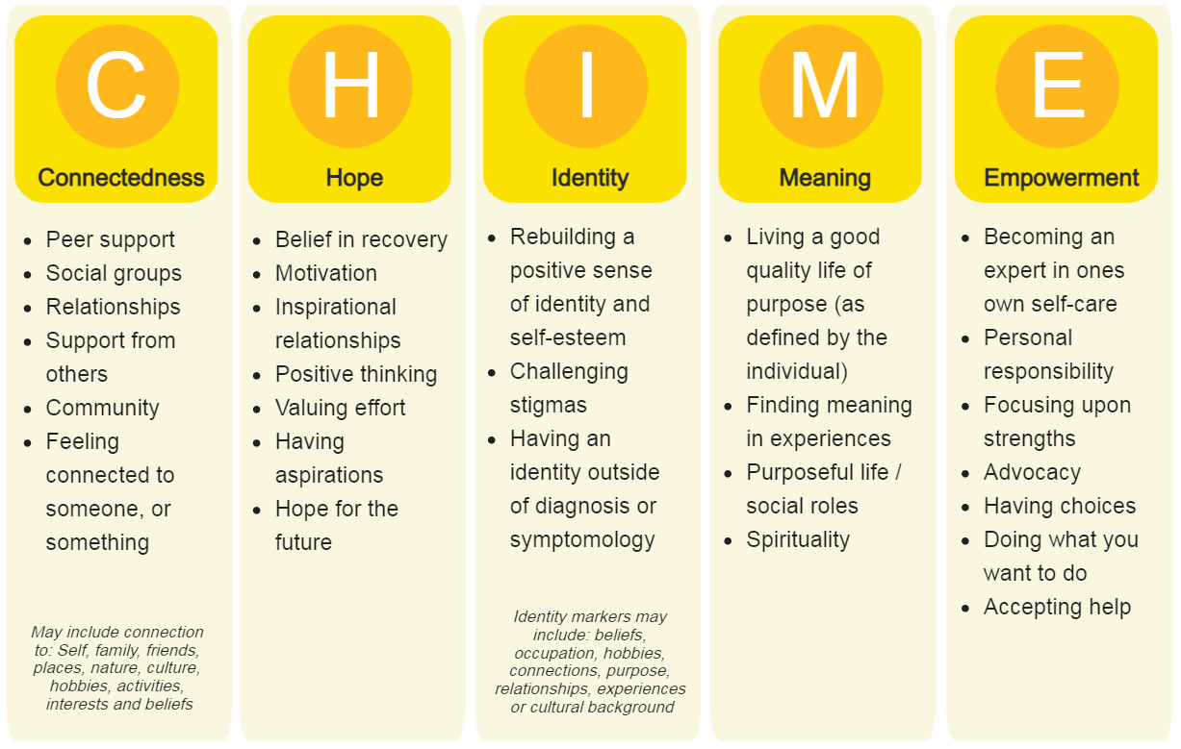

Slide 9
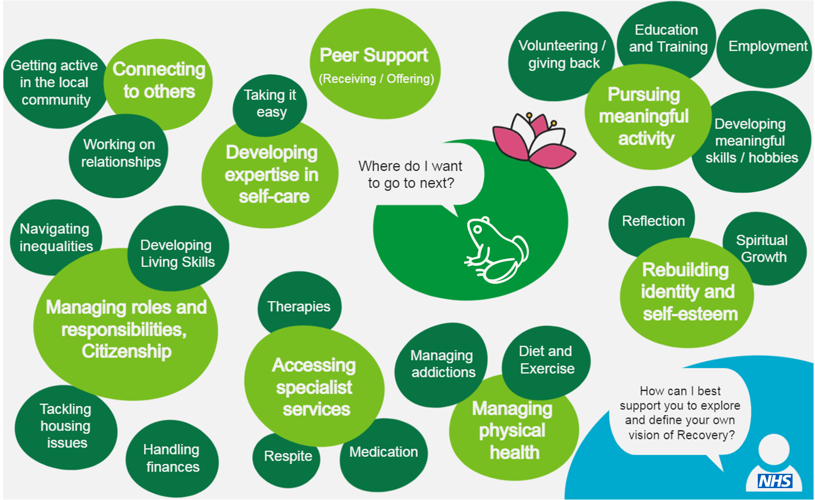

Slide 10
‘Recovery’ is distinct from the medical model
In a medical model, it’s the healthcare professional who decides that there’s something ‘wrong’ with you before prescribing some sort of ‘treatment’ to ‘cure’ you. It is often focuses on what’s ‘wrong’ with you in an attempt to make you more ‘normal’ or a ‘contributing member of society’. In this paternalistic approach, you are a passive ‘patient’ whilst the professional is an active, authoritarian ‘fixer’ of problems.
It is ‘The Good Doctor’ who decides what is best for you. The power lies with them.
In a recovery / person led model, it is you who is the authority on you. You know better than anybody about your needs, preferences, motivations, desires, what works for you and what hinders you. You know what ‘normal’ or ‘healthy’ or ‘well’ looks like for you, and what actions are reasonable for your circumstances and what isn’t’. In this holistic approach, you are an active participant in your health. You may defer to the expertise of healthcare professionals if you want to.
It is you who makes informed decisions for yourself. The power lies with you.

Slide 11
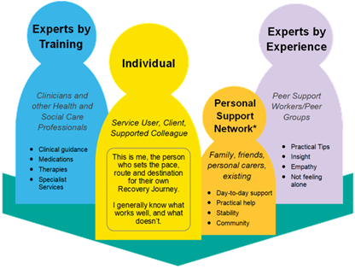
The person leads from the front

Slide 12
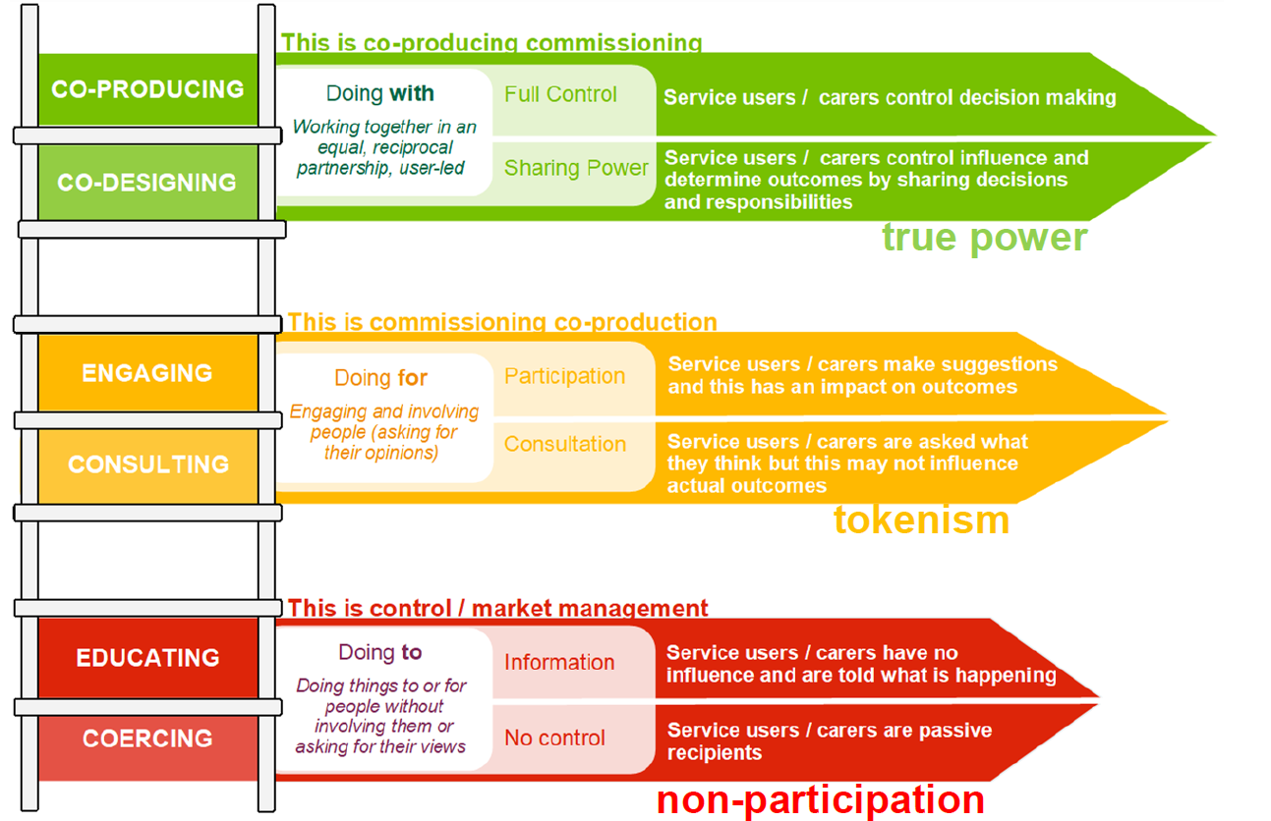
Recovery is a reclaiming of power at every level of decision making

Slide 13
Recovery is…
A journey for some, a destination for others
Placing the person and their self-defined goals at the centre of their care
Having choices and advocacy
Valuing personal lived experience and the resulting personal growth
Strengths-based learning
Coproduction and shared decision making
Challenging stigmas and blurring the harmful ‘us-them’ distinction
Building relationships and connecting to others in the community
Addressing power imbalances through the disuse of disempowering language and outdated, patronising and/or discriminatory clinical practices

Slide 14
Recovery is NOT…
Something ‘extra’ I, or others, now need to do
‘Just the latest model’ that will be replaced with something else before long
That others are responsible for my personal wellbeing
Something that doesn’t apply to ‘my patients’ or ‘my role’
A complete cessation of symptoms achieved as a result of ‘making’ people independent and ’normal’ through ‘interventions’ and ‘treatments’
Closing or replacing existing services
That contributing to society can only happen after the person has recovered
An excuse to shift all responsibility onto ‘me’, the service user
About living ‘symptom-free’

Slide 15
Discussion?
Any surprises? Any changes in perspective? Want anything expanding on?

Slide 16
Recovery College e-courses
What is Recovery?
Defining and critically exploring Recovery in much more depth than we have done today.
What is Coproduction?
Understanding what coproduction is, why it’s important and how to apply it at every level of decision making (especially within health and social care)
How can we best support Recovery?
Exploring how stigma, culture, language and relationships can help or hinder someone’s Recovery Journey

Slide 17
Thank you

