Slide 1

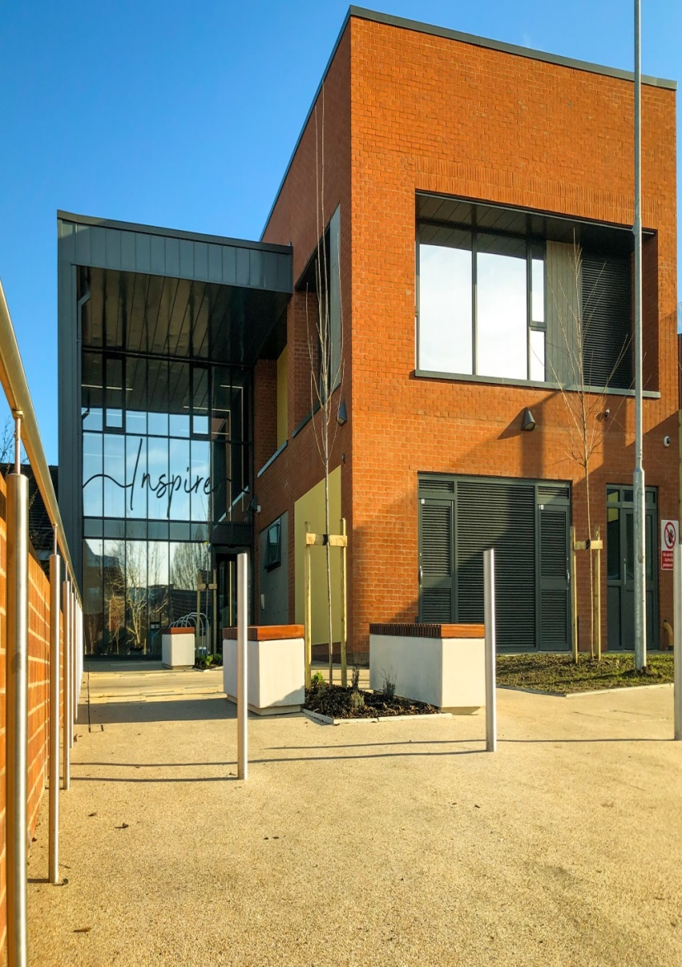






What will the Associate Hospital Managers consider during the review?
If you are detained in hospital on a section they should consider whether:
you still have a mental health problem and if so, how serious it is
you still need assessment and treatment (or treatment) in hospital
your health would be at risk, or your safety or someone else’s safety, would be at risk if you were discharged from the section and/or left hospital
there are other less restrictive options, such as whether you can be treated for your mental health problem in the community, and appropriate treatment will still be available to you.
If you are on a Community Treatment Order
The Associate Hospital Managers can discharge you in the same way as from an inpatient section, but instead of looking at whether you are well enough to leave hospital (or will be able to receive the right treatment in the community), they will look at whether your Doctor still needs the power to recall you to hospital, and possibly have you brought there for treatment.
What if the Associate Hospital Managers discharge me from the section?
If they discharge you from the section, you can either leave the hospital or it may be in your interest to stay a little longer in hospital as a voluntary patient if the medical team agree to this.
CONTACT US
For further information, please contact the Mental Health Legislation Team via email at:
hnr-tr.mentalhealthlegislation@nhs.net
Copies are available in different languages.
Complaints and Feedback Team
Humber Teaching NHS Foundation Trust
Trust Headquarters
Willerby Hill
Beverly Road
Willerby
HU10 6ED
Mental Health Act
Associate Hospital Managers' Reviews
Patient Information Leaflet
01482 303930
HNF-complaints@nhs.net
HumberNHSFT
HumberNHSFT
humber.nhs.uk
Publication Date: June 2022
Review Date: June 2023
Notes:
GUIDE:
Before saving as a PDF file for printing purposes, make sure to DELETE the two blue separating ‘fold’ lines.

Slide 2
The form is then sent through to the Mental Health
Legislation team, who will consider your request and arrange the review for you, if appropriate.
You can ask for a review as many times as you like although it may not be appropriate if you have recently had one or if you have a Tribunal coming up.
What’s the difference between an Associate Hospital Managers’ review and a Tribunal?
A Tribunal is an independent court of law with power to discharge patients; an AHMs’ review is an independent panel of lay people with power to discharge patients.
You can only apply to the Tribunal up to twice a year but as stated above you can apply to the hospital managers more frequently.
The AHMs’ reviews are intended to be more relaxed than Tribunals.
What happens before an Associate Hospital Managers’ review?
Unless there is an issue of safety, you should always be given the opportunity to speak to the panel alone before the review, with or without anyone who is representing or accompanying you.
Before the review meeting, the panel will look at all the relevant information, including any recent reports from professionals involved in your care.
They are likely to look at reports from your:
Responsible Clinician (Doctor)
Named Nurse (if inpatient)
Social Worker or other healthcare professional involved in your care
This is because the AHMs will need to look at your current circumstances and treatment, as well as past history of care and treatment, and details of future plans.
They will focus especially on any recent risk, any history of neglect, self-harm or harm to others. You will be given a copy of these reports unless there is
a valid reason not to. If you have a solicitor they
should be allowed to see all the information relating to your detention.
You should be provided with this information in good time before the review meeting so that you, and your legal representative if you have one, have the opportunity to consider it and prepare for the review meeting.
What happens at an Associate Hospital Managers’ review?
An AHMs' review is held in a separate room on the Ward or Unit, or it may be remote via video link.
Apart from yourself the following people will usually be there:
The panel of three Associate Hospital Managers
Your responsible clinician (Doctor)
A nurse from the ward (if inpatient)
A social worker or other healthcare professional involved in your care
You can have someone there to support you, for example: solicitor, relative, friend, carer or advocate.
During the review your responsible clinician and other professionals will be asked to give their views on whether keeping you on the section or a Community Treatment Order is justified and to give reasons. You will then have a chance to speak (this is as well as having the opportunity to speak to the panel alone before the review).
At the end of the review the Associate Hospital Managers will decide if you should stay on your section or be discharged. All 3 of them have to agree in order for you to be discharged. Usually they will tell you their decision at the end of the review. They may occasionally need to consider adjourning the review so that they can ask for more medical or other professional advice.
If they decide not to discharge you they will give their reasons to you both verbally and in writing.
Who are the Associate Hospital Managers?
Associate Hospital Managers (AHM) are independent people appointed by the Trust specifically to review patients’ detention under the Mental Health Act.
The decision about whether or not to discharge you from the section or Community Treatment Order is made by a panel of three people called (in our Trust) ‘associate hospital managers’.
They are independent of the Trust and cannot be employees of the Trust.
The name “hospital managers" can be confusing. In this case, it does not mean the people who run either the hospital or the Trust.
Who can ask for an Associate Hospital Managers’ review?
You can apply for an AHMs’ review at any time if you are subject to a:
section 2
section 3
section 37
Community Treatment Order
The AHMs can also review a request for discharge from your Nearest Relative if that request is challenged by the Responsible Clinician.
The Nearest Relative is not necessarily the same as the next of kin. The next of kin has no rights under the Mental Health Act.
The AHMs will review your detention every time your section is due to be renewed or extended to make sure that you are not kept on a section for longer than you need to be.
How can I apply to have my detention reviewed by the Associate Hospital Managers?
You can speak to nursing staff or your key nurse who will print off a form for you to complete. They can also complete this on your behalf if you wish. If you wish to have a solicitor present you will need to pick one from the list provided to you and add this to the form.
Supporting young people
and their families in Hull and
the East Riding of Yorkshire.
Notes:
GUIDE:
Before saving as a PDF file for printing purposes, make sure to DELETE the two blue separating ‘fold’ lines.

