Slide 1
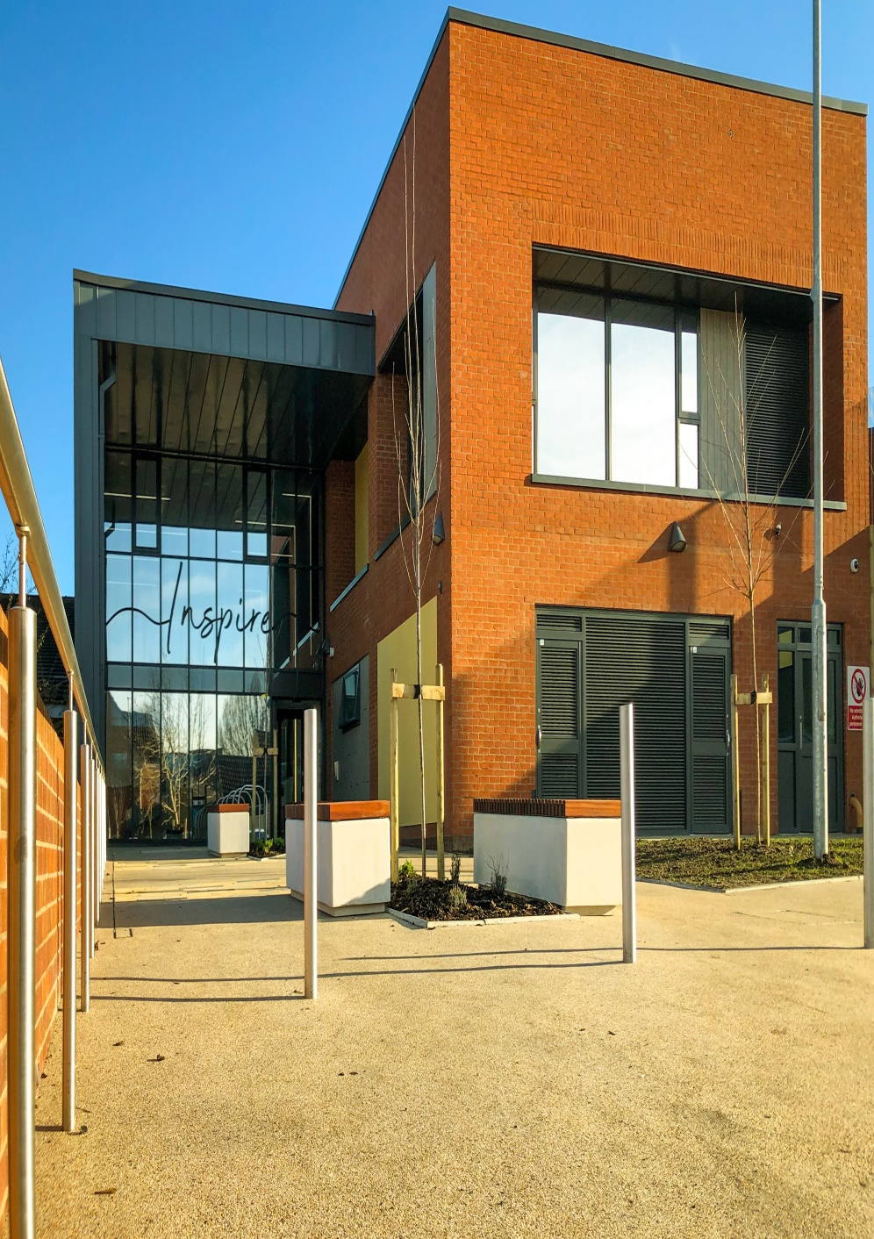


Complex Emotional Needs Service
Supporting those with
emotion dysreguation
across Hull and
East Yorkshire
Publication Date: June 2023
Review Date: June 2025

Slide 2
Complex Emotional Needs Service
Who we are
The Complex Emotional Needs Service (CENS) is a psychology led, multidisciplinary team, with Clinical Psychologists, Advanced Practitioners (from various registered professions), an Assistant Psychologist, and a Support Time & Recovery Worker. There are also DBT Therapists, DBT Skills Trainers, Training Facilitators (Experts by Experience and Experts by Profession) who work within the wider functions of CENS.
Our aims
CENS aims to work for people who may experience difficulties consistent with the construct of a ‘Personality Disorder’, to enable them to develop a life of value to them.
What we do
Most of our work in CENS is centred around supporting systems and services to work more effectively with individuals they support, maintaining access to mainstream services, minimising transitions in care, and utilising and developing the skills that already exist within
teams.
This is accessible through:
Consultation offered by a qualified clinician within the team, typically involving attendance at professionals meetings.
Supervision which is usually offered by a psychologist within the team.
Bespoke training for supported living providers to support understanding of formulated needs for care coordinated individuals within CENS.
Knowledge and Understanding Framework (KUF) training on complex mental health needs associated with a ‘Personality Disorder’ for both internal staff and external agencies who support care coordinated individuals.
CENS will provide time limited keyworking to a small number of individuals who present with needs that are consistent with a diagnosis of a ‘personality disorder’ (with no formal diagnosis needed), and where there are formulated needs that might be addressed by a more intensive, psychologically informed, and/or flexible approach to keyworking.

Slide 3
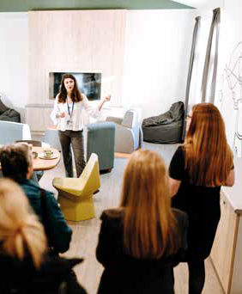
Other functions that sit within CENS include:
Dialectical Behaviour Therapy (DBT)
Family Connections
KUF training
CAMHS transition consultations
How to access our services
Consultation (including CAMHS transitions) and supervision can be requested via email: hnf-tr.CENS@nhs.net
Keyworking within CENS does not have a direct referral process. A 12 week assessment is only offered following accessing the consultation process if it is agreed, both during consultation and within the CENS MDT, that keyworking is likely to be beneficial.
For more information regarding DBT, including referral guidance and documents, please visit:
https://intranet.humber.nhs.uk/dialectical-behaviour-therapy-service.htm
For more information regarding Family Connections, including how to
refer, please visit:
https://www.humber.nhs.uk/Services/humber-family-connections.htm
For more information on KUF Training, or to book on, please email:
hnf-tr.kufhumber@nhs.net

Slide 4








CONTACT US
Complex Emotional Needs Service (CENS) (humber.nhs.uk)
Complex Emotional Needs Service:
01482 689156
Mental Health Advice and Support Line: 0800 138 0990
Emergency Services: 999
Complaints and Feedback Team
Humber Teaching NHS Foundation Trust
Trust Headquarters
Willerby Hill
Beverly Road
Willerby
HU10 6ED
01482 303930
HumberNHSFT
HNF-complaints@nhs.net
HumberNHSFT
humber.nhs.uk

